Slide 1
Customer Advisory Team Customer Insights Dynamics 365
Accelerate Customer Success

Slide 2

Initiate
Initiate
Implement
Prepare
Operate
Align customer, partner, and CAT expectations
Understand the customer vision, goals, kpi’s, key stakeholders, support and governance models
Create a joint understanding about the project and accountabilities. Define overall project context and solution
High level architecture, relevant data sources and proposed solution

Slide 3

Implement
Initiate
Implement
Prepare
Operate
Functional and technical design guidance
Solution modeling and data source review
Provide timely guidance across functional, technical, and implementation aspects of the solution
Integration and Implementation best practices

Slide 4

Prepare
Initiate
Implement
Prepare
Operate
Go-live planning
Testing and acceptance
Go live with confidence to bring users onboard and have them adopt the solution
User readiness

Slide 5
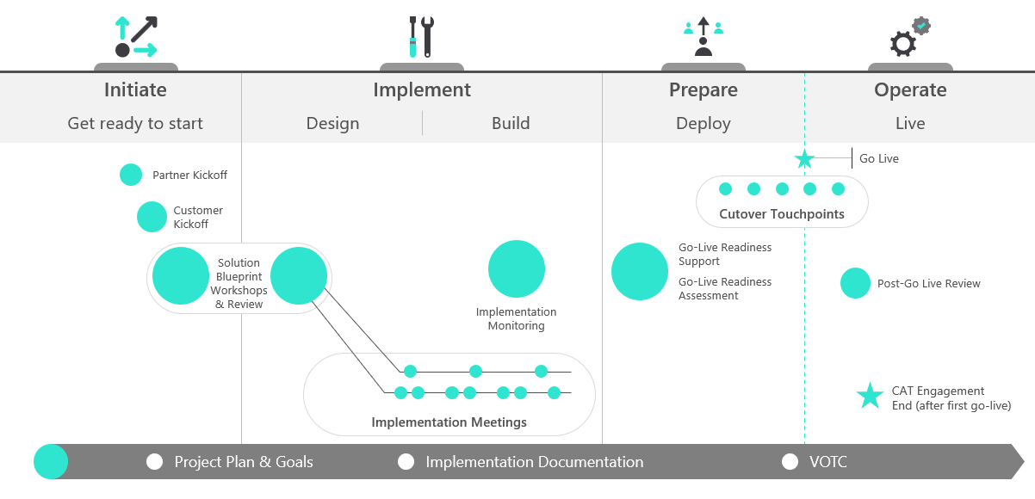
What Customer Advisory Team Offers
Each phase of CAT engagement Initiate, Implement, Prepare is aligned to Solution Blueprint, Implementation success and Go-live Readiness.
Workshops will be used for follow-up actions and project status tracking.
We will leverage documentation and direct engineering engagement to address any knowledge gaps identified during Workshop.
HE ADLINES

Slide 6
The key to your success
Workshops
Workshops are interactive, outcome-based and involve assessments using checkpoints. Customers and partners can provide input prior to the workshop to be able to deliver a tailored session.
Workshop follow-ups
These follow-ups allow customer and Customer Advisory Team SA to provide update on the action items from the workshops and provide opportunity to get technical clarifications and discuss any deployment roadblocks.
Technical talks
Technical talks are focused on providing technical depth and best practices to empower their team with more knowledge specific to the subject areas. These recorded talks often provide overviews of available tooling and/or content.

Slide 7

Roles and Responsibilities
Depending on project scope and implementation methodology, the below represents a common division of responsibilities between the customer and the partner:
CUSTOMER
PARTNER
Overall program and project management of customer resources
Developing requirements that meet the program vision and objectives
To-Be business process design
Resource accountable for driving end user adoption of service.
End-user communications, training, and change management.
Help-desk documentation and training.
All implementation activities including requirements analysis, solution design and documentation.
Configuration and setup required for the product based on customer requirements.
Modifications to Dynamics 365 beyond the configurable options – embedded PowerApps, Integrations, Custom Attributes, etc.
Support customer with Data prep, modeling, Security roles setup, User training
Provide customer with first level product assistance/support
On-boarding guidance.
Solution Blueprint Review to ensure alignment with Dynamics 365 capabilities.
Workshop follow-ups to ensure alignment with best practices.
Technical Talks for deeper technical guidance on specific topics.
Product roadmap and related feedback loop.
Participation in steering committee meetings.

Slide 8
CAT Logical Approach
Initiate
Implement
Prepare
Operate
Get ready to start
Design
Build
Deploy
Live
Go Live
Partner Kickoff
Cutover Touchpoints
Customer
Kickoff
Solution Blueprint Workshops
& Review
Implementation Monitoring
Go-Live Readiness
Workshop
Go-Live Readiness
Assessment
Post-Go Live Review
Implementation Workshops
Project Plan & Goals
Implementation Documentation
VOTC

Slide 9
CAT Logical Approach
Standard Topics
Business Vision
Initiate
Implement
Success Criteria
Get ready to start
Design
Business Scenario Identification
KPIs
Partner Kickoff
Stakeholders & Owners
Customer
Kickoff
Review Current Architecture
Solution Blueprint Workshops
& Review
Review Data Estate
Identify Key Data Sources
Scope Project & Determine Timeline
Confirm Environment Set-up
Sprint Alignment
Target Go Live Date

Slide 10
Implementation Approach
Standard Topics
Customer Insights
Review Customer Context
Review and Prep Data
Implement
Data Ingestion
Design
Build
Conflation
Enrichment
Segments & KPIs
Review
Customer Context
Review & Prep Data
Data Ingestion
Conflation
Enrichment
Segments & KPIs
Activation
Extensibility
AI / ML Problem Formulation
Model Development
Model Validation & Explain-ability
AI / ML Problem
Formulation
Model
Development
Model Validation &
Explain-ability
Visualization
Segments & KPIs
Visualization
Activation
Extensibility

Slide 11
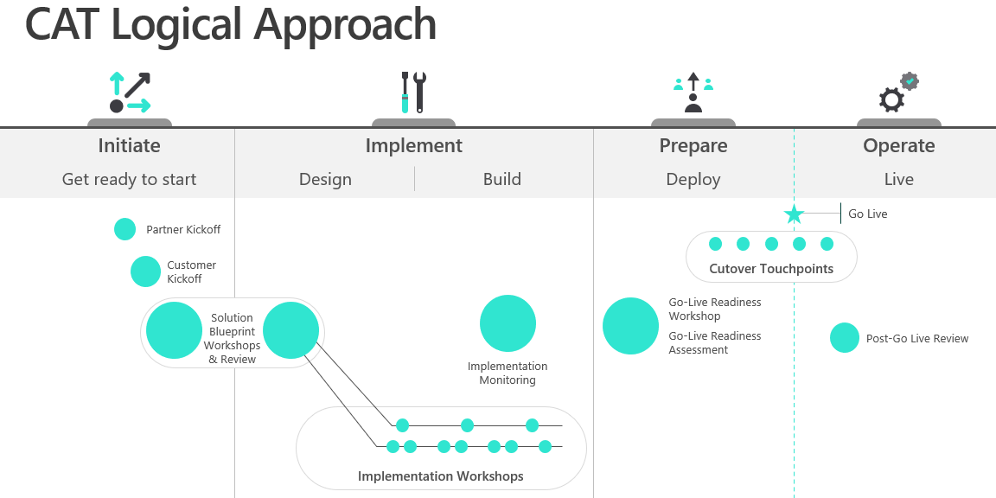
Customer Insights Implementation Support
Microsoft Engineering Commitment
Dedicated Solution Architect & Product Engineering to support Customer Insights Implementation
Provide implementation guidance and best practices for CI implementation from Initiate to Deploy stages
Architectural guidance and input as it relates to Cloud and Data Architecture with Customer Insights
Deep technical and roadmap support to ensure solution is built with future state in mind

Slide 12

© 2020 Microsoft Corporation. All rights reserved. Microsoft, Microsoft Dynamics, Office 365, Windows, and other product names are or may be registered trademarks and/or trademarks in the U.S. and/or other countries. The information herein is for informational purposes only and represents the current view of Microsoft Corporation as of the date of this presentation. Because Microsoft must respond to changing market conditions, it should not be interpreted to be a commitment on the part of Microsoft, and Microsoft cannot guarantee the accuracy of any information provided after the date of this presentation. MICROSOFT MAKES NO WARRANTIES, EXPRESS, IMPLIED OR STATUTORY, AS TO THE INFORMATION IN THIS PRESENTATION

